Slide 1
Measuring the Success of Acquisition Reform by Major DoD Components
Andrew Hunter, Director, Defense-Industrial Initiatives Group and Senior Fellow, International Security Program
Rhys McCormick, Research Assistant, Defense-Industrial Initiatives Group
May 13, 2015

Slide 2
Methodology
The Federal Procurement Data System (FPDS) was the primary source for this report.
Federal regulations only require that all unclassified prime contracts worth $2,500 and above be reported to FPDS.
Overseas Contingency Operations funding and other supplementals are not separately classified in FPDS.
The study team analyzed contracts using contract signed dates to divide the contracts into reform periods for analysis.
The reform periods were determined by the date the final implementing guidelines were issued.
All dollar figures are in constant 2014 dollars.

Slide 3
Study Questions
Have the DoD components increased their rate of effective competition since the introduction of BBP in 2010?
How successful have the components been at promoting contracting opportunities for small businesses?
Contract Type: Have the DoD components implemented the guidance in BBP 2.0 regarding the proper mix of fixed price and cost plus contracts?

Slide 4
Competition
Have the DoD components increased their rate of effective competition since the introduction of BBP in 2010?
Reform Periods
Pre-Better Buying Power 1.0: April 27, 2009 – November 2, 2010
Better Buying Power 1.0: November 3, 2010 – April 23, 2013
Better Buying Power 2.0: April 24, 2013- September 21, 2014

Slide 5
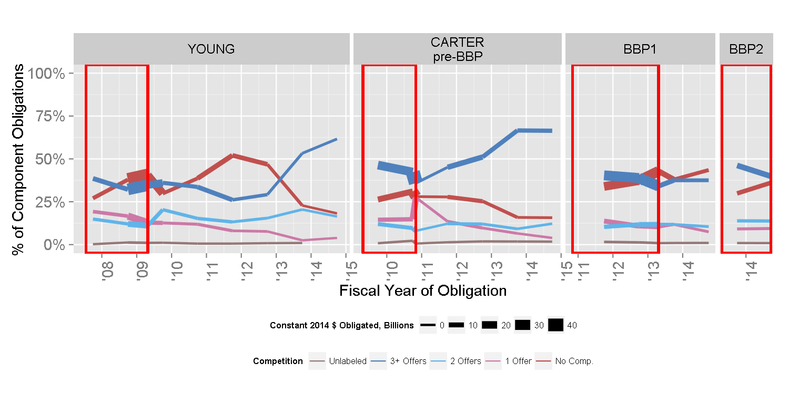
Army Competition by Starting Regime
Notes:
Pre BBP In Pre-BBP Out BBP 1.0 In BBP 1.0 Out BBP 2.0
1 Offer 15% 14% 12% 11% 9%
2 Offers 10% 11% 11% 11% 14%
3+ Offers 43% 46% 39% 39% 42%
No Comp. 29% 28% 37% 37% 34%
Unlabeled 2% 2% 1% 1% 1%

Slide 6
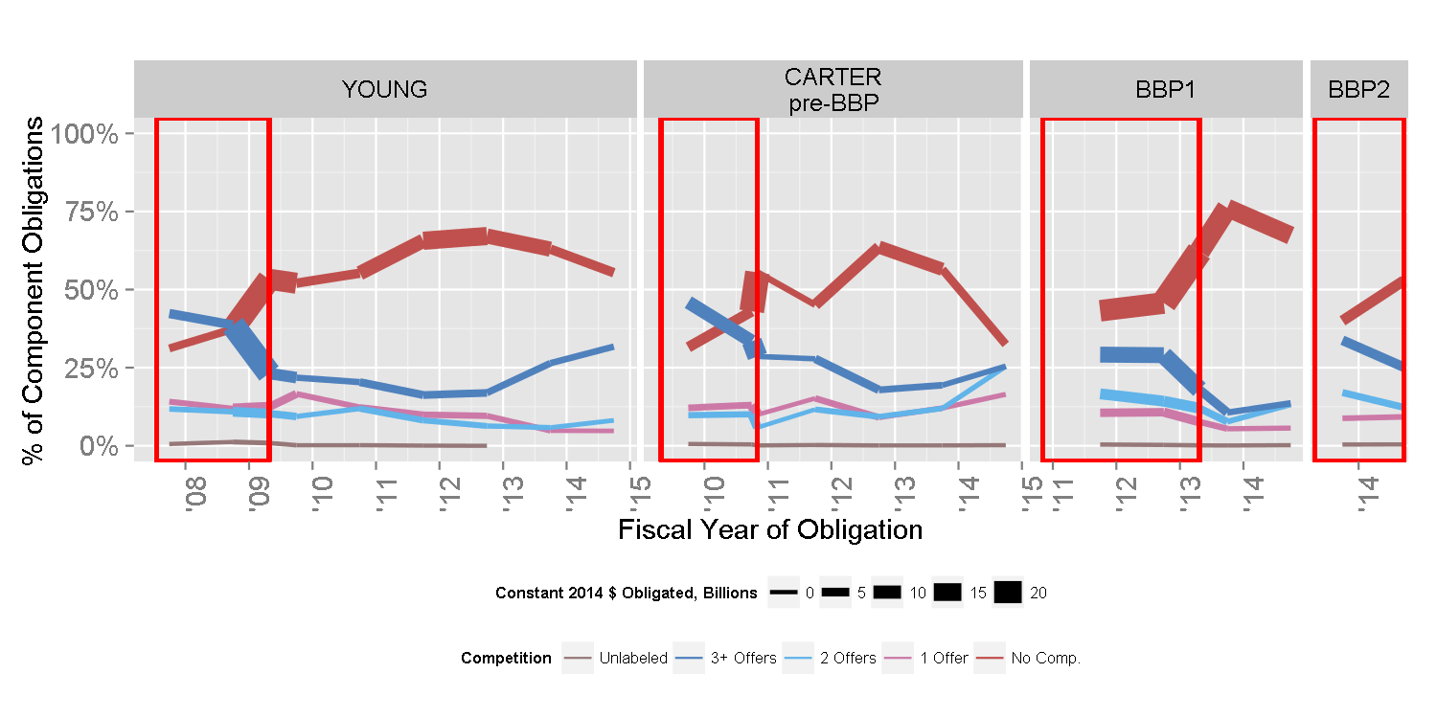
Navy Competition by Starting Regime

Slide 7
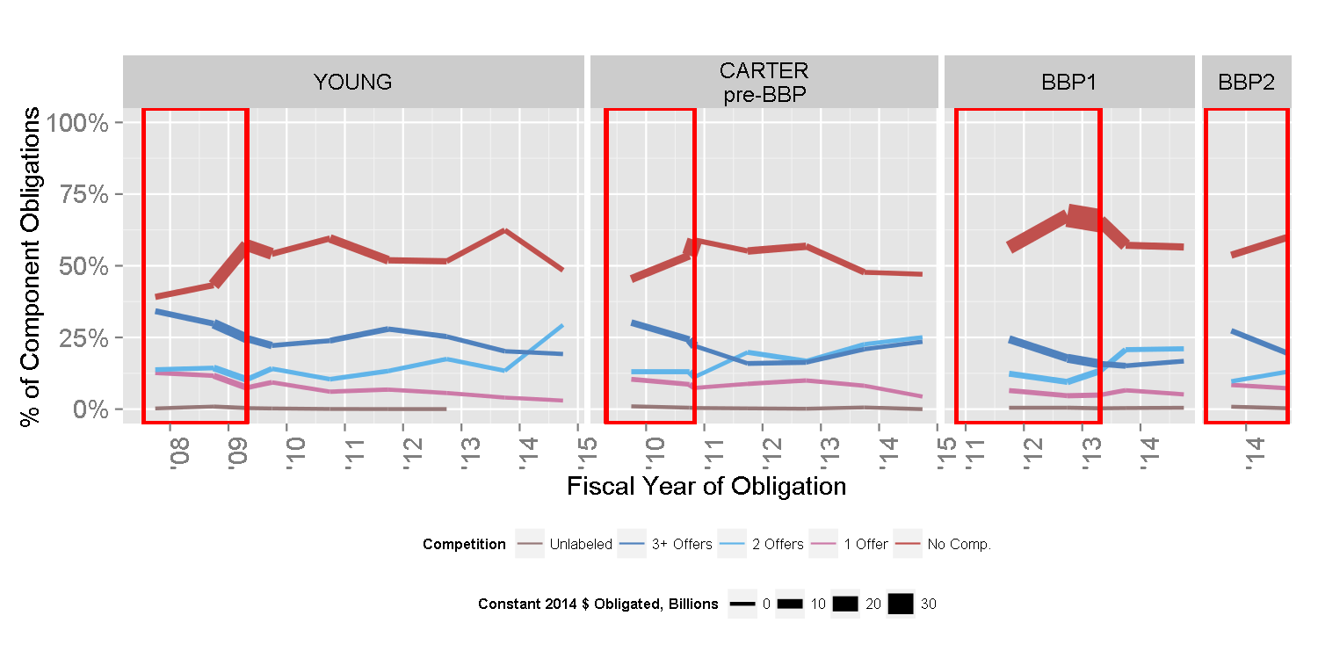
Air Force Competition by Starting Regime

Slide 8
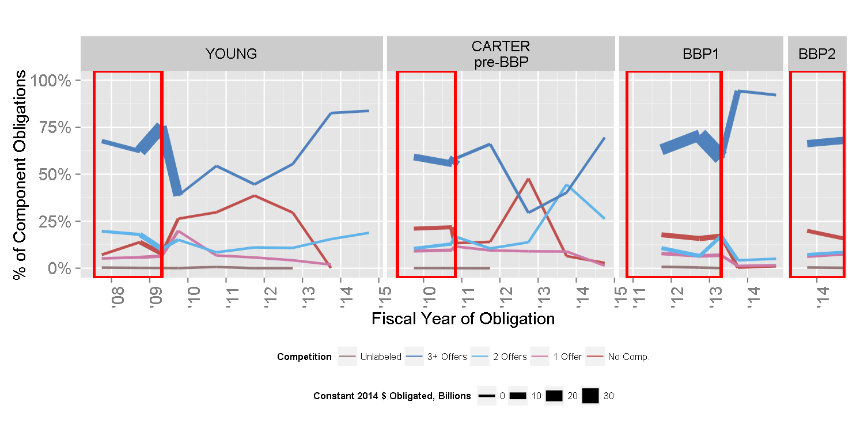
DLA Competition by Starting Regime

Slide 9
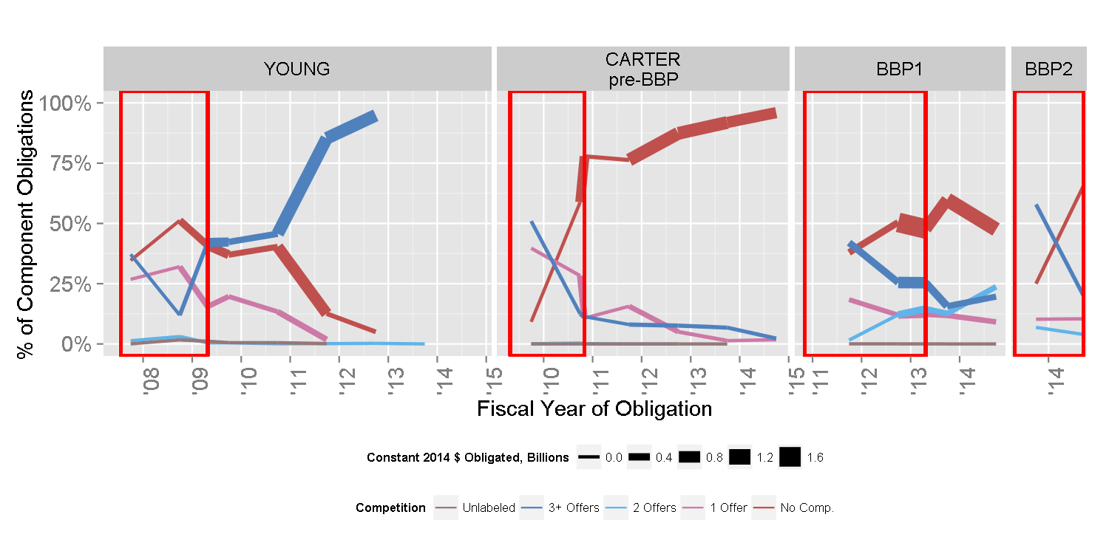
MDA Competition by Starting Regime

Slide 10
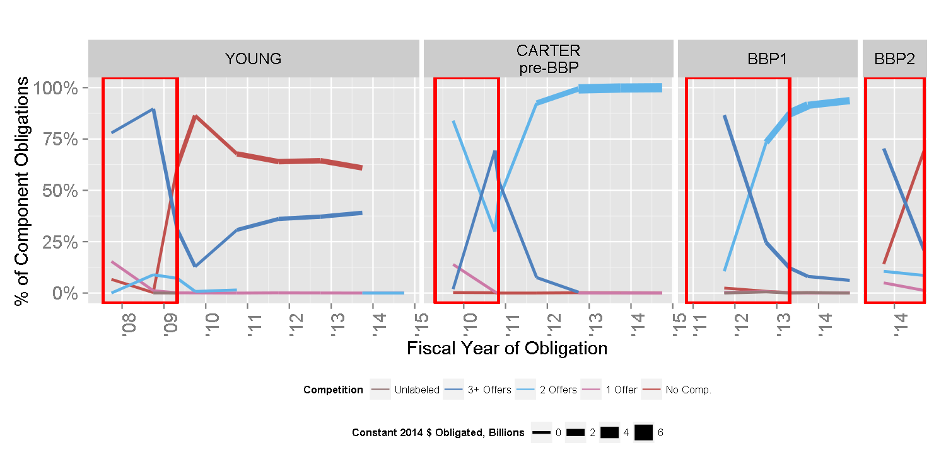
Military Health Competition by Starting Regime

Slide 11
Vendor Size
How successful have the components been at promoting contracting opportunities for small businesses?
Reform Periods
Pre-Small Business Task Force: April 27, 2009 – September 22, 2010
Small Business Task Force: September 23, 2010 – April 23, 2013
Better Buying Power 2.0: April 24, 2013- September 21, 2014

Slide 12
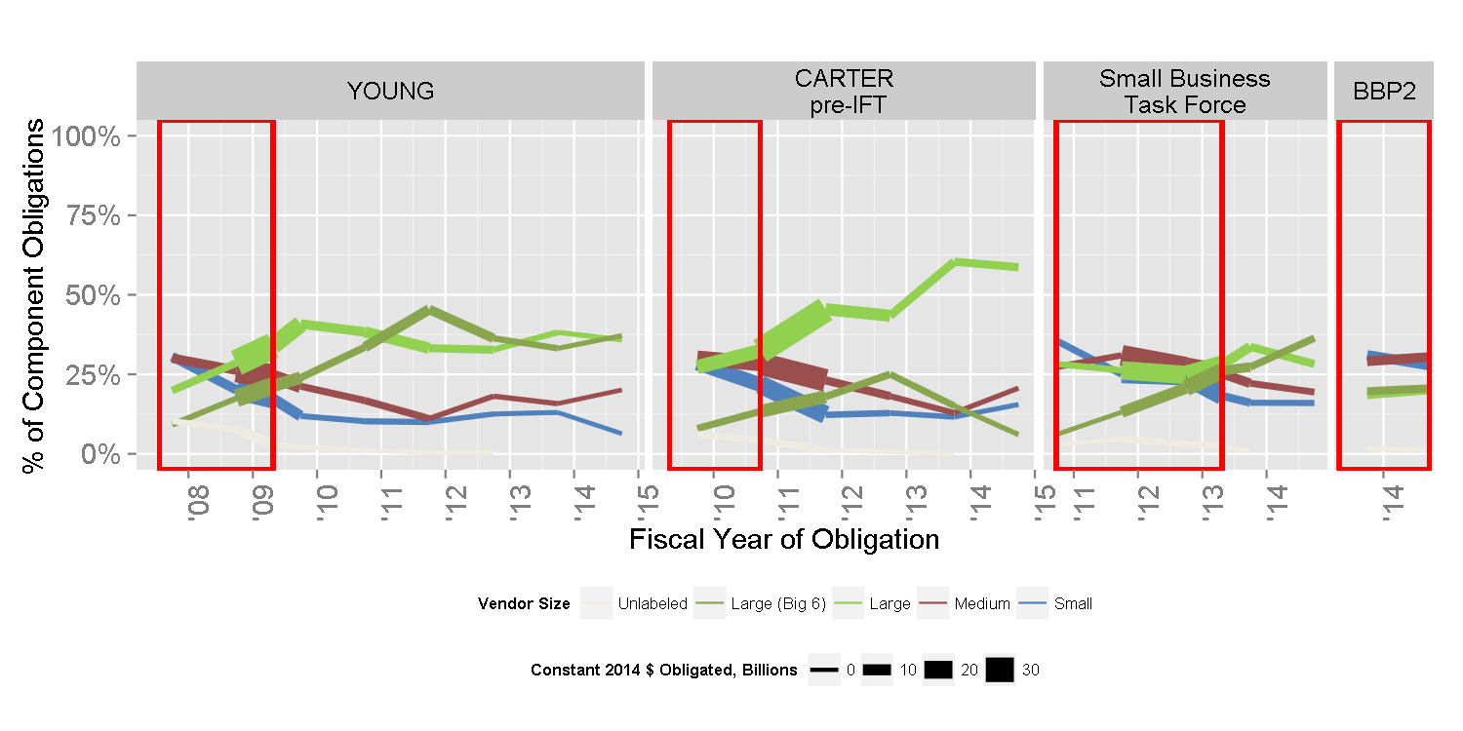
Army Vendor Size by Starting Regime

Slide 13
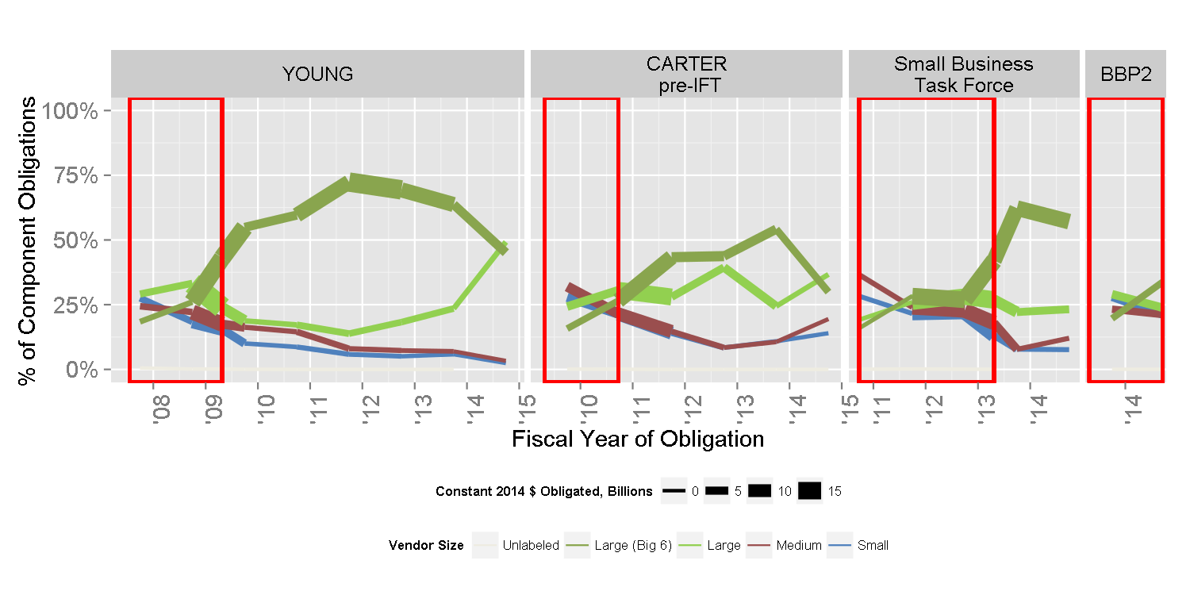
Navy Vendor Size by Starting Regime

Slide 14
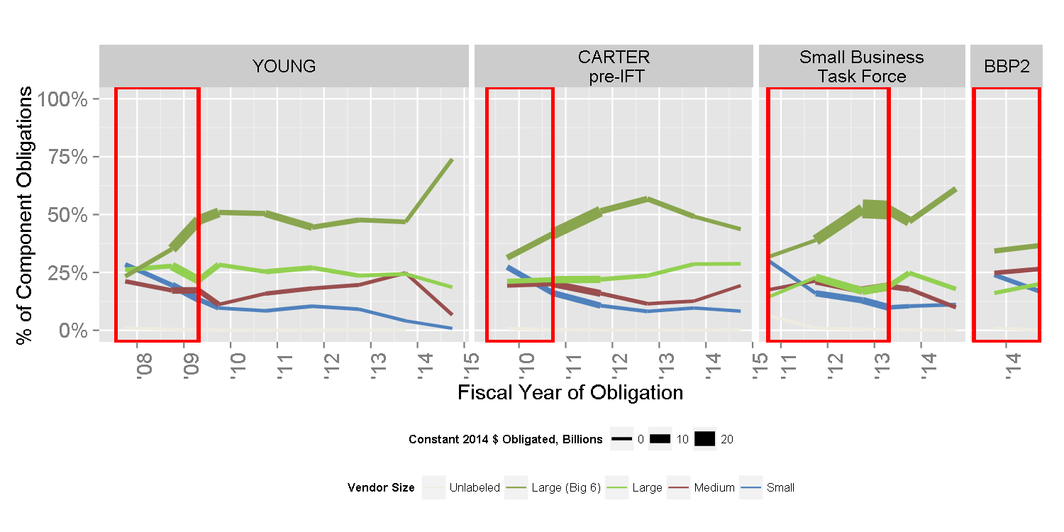
Air Force Vendor Size by Starting Regime

Slide 15
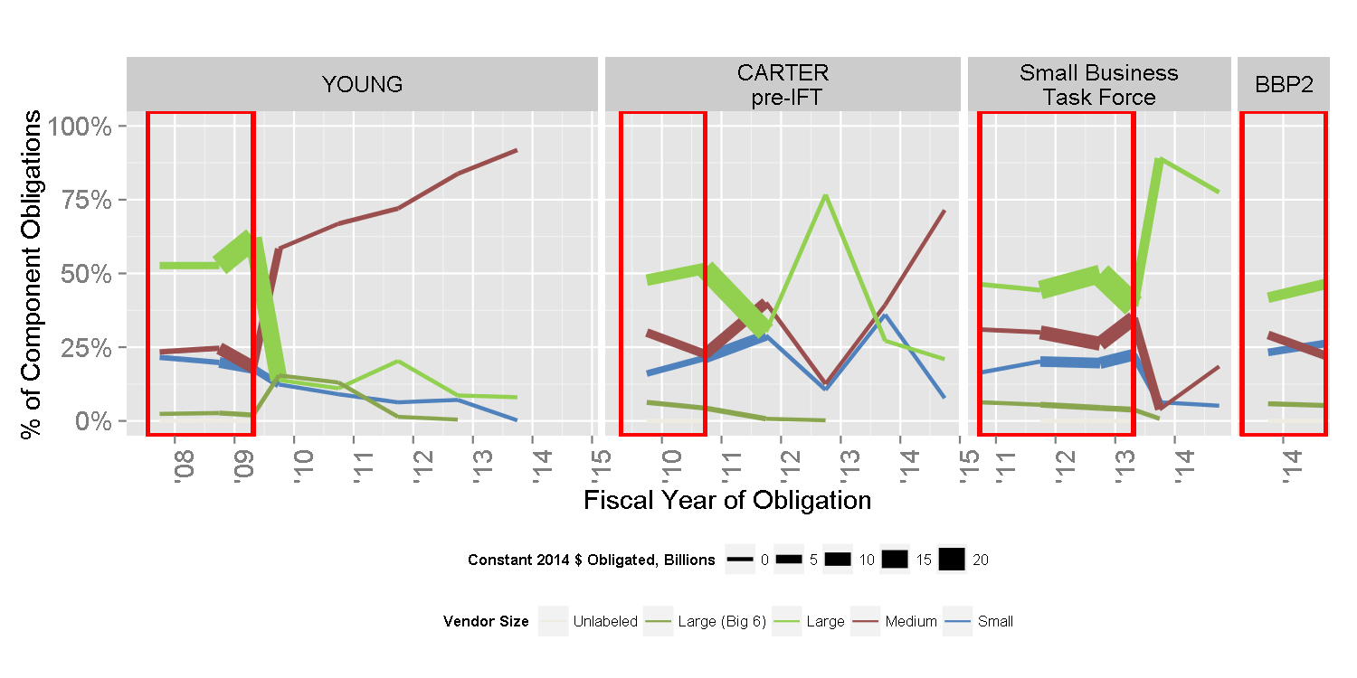
DLA Vendor Size by Starting Regime

Slide 16
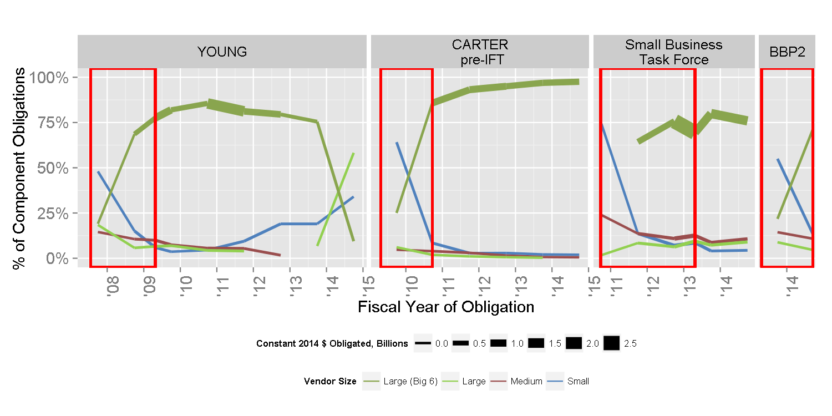
MDA Vendor Size by Starting Regime

Slide 17
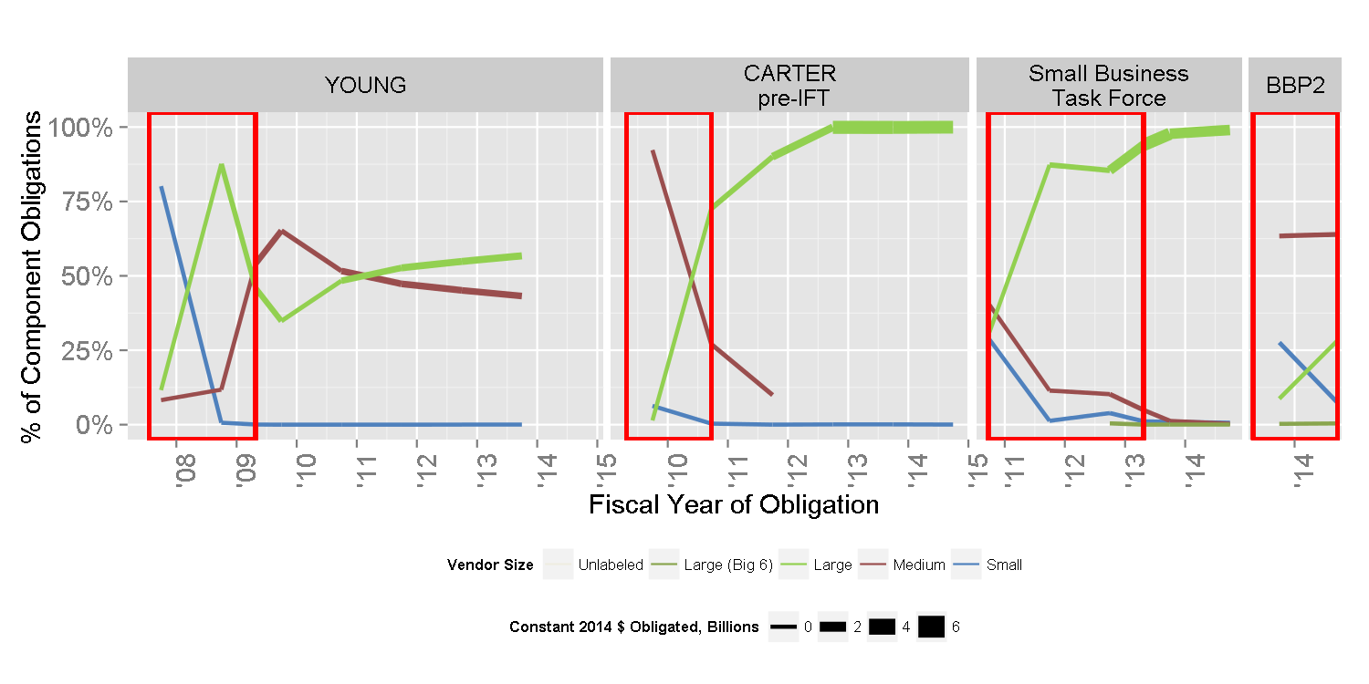
Military Health Vendor Size by Starting Regime

Slide 18
Pricing Mechanism
Have the DoD components implemented the guidance in BBP 2.0 regarding the proper mix of fixed price and cost plus contracts?
Reform Periods
Pre-NDAA: April 27, 2009 – March 15, 2011
2009 NDAA Section 864: March 16, 2011 – April 23, 2013
Better Buying Power 2.0: April 24, 2013- September 21, 2014

Slide 19
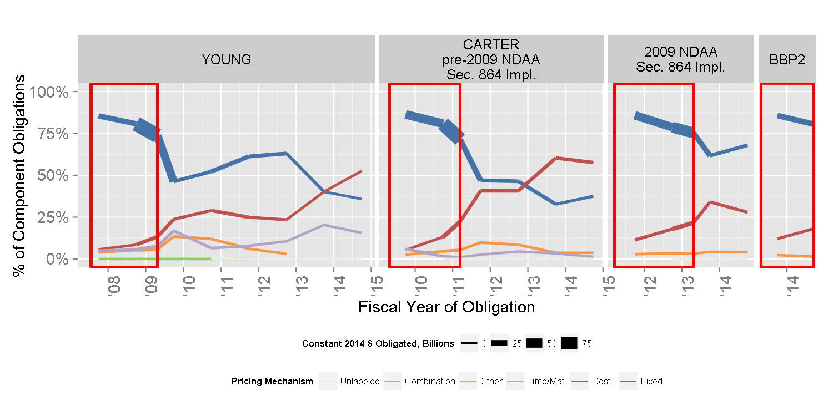
Army Pricing Mechanism by Starting Regime

Slide 20
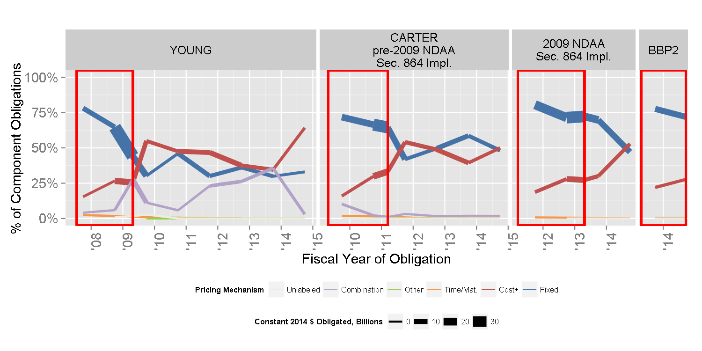
Navy Pricing Mechanism by Starting Regime

Slide 21
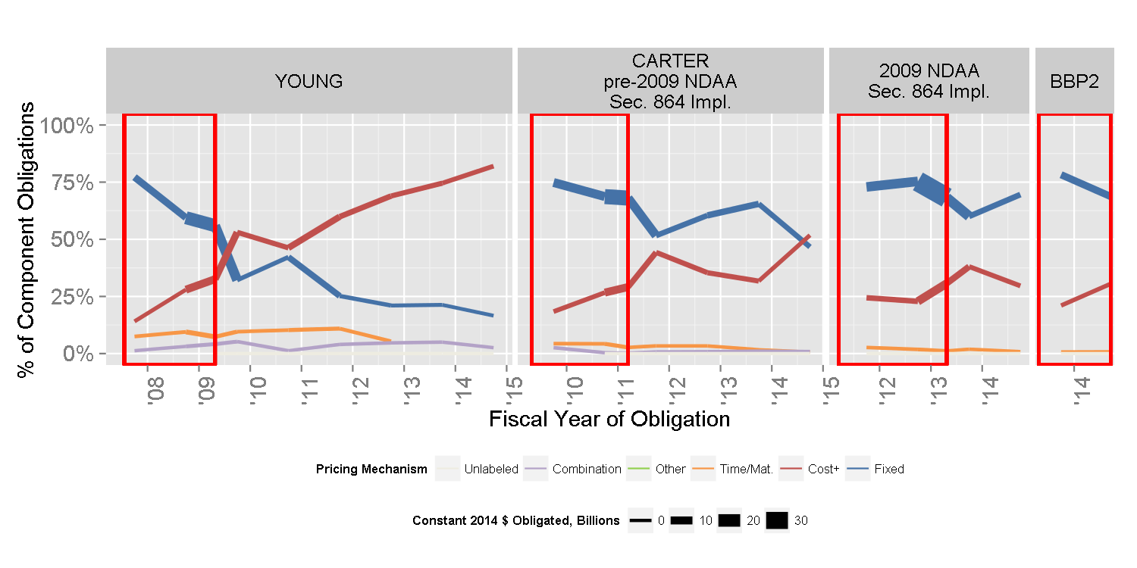
Air Force Pricing Mechanism by Starting Regime

Slide 22
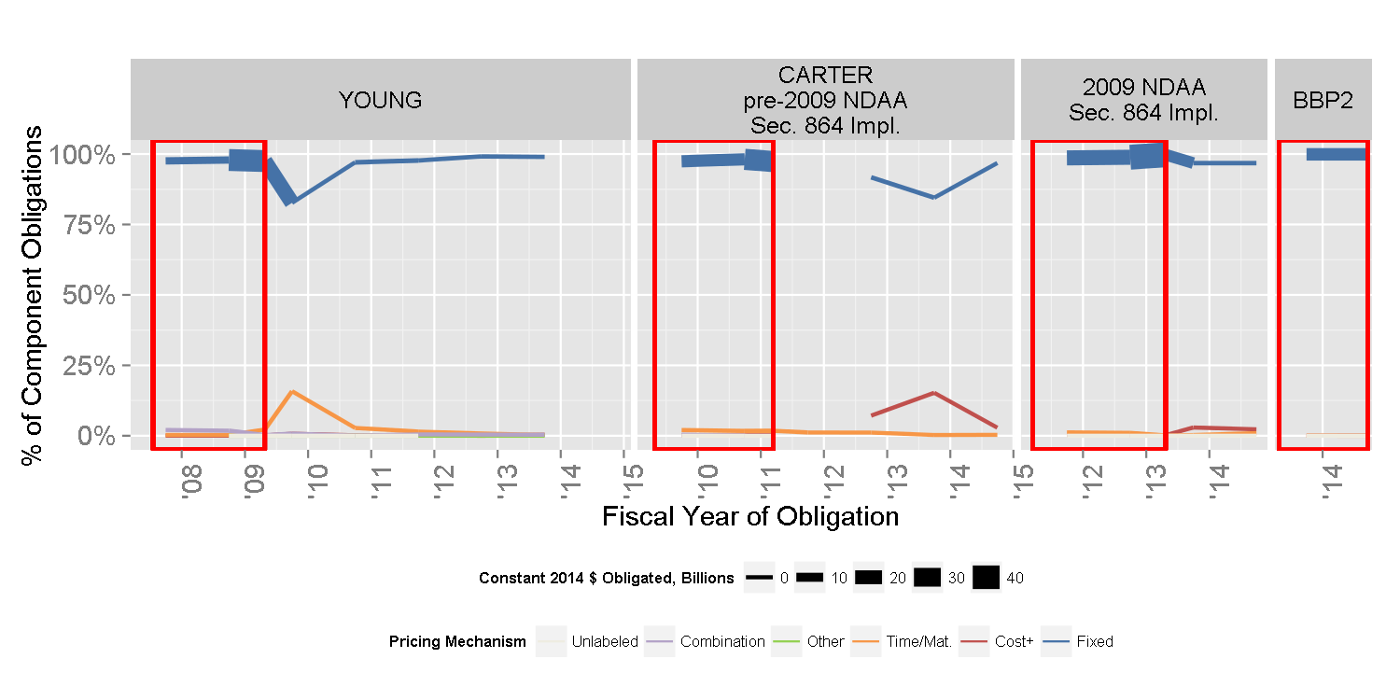
DLA Pricing Mechanism by Starting Regime

Slide 23
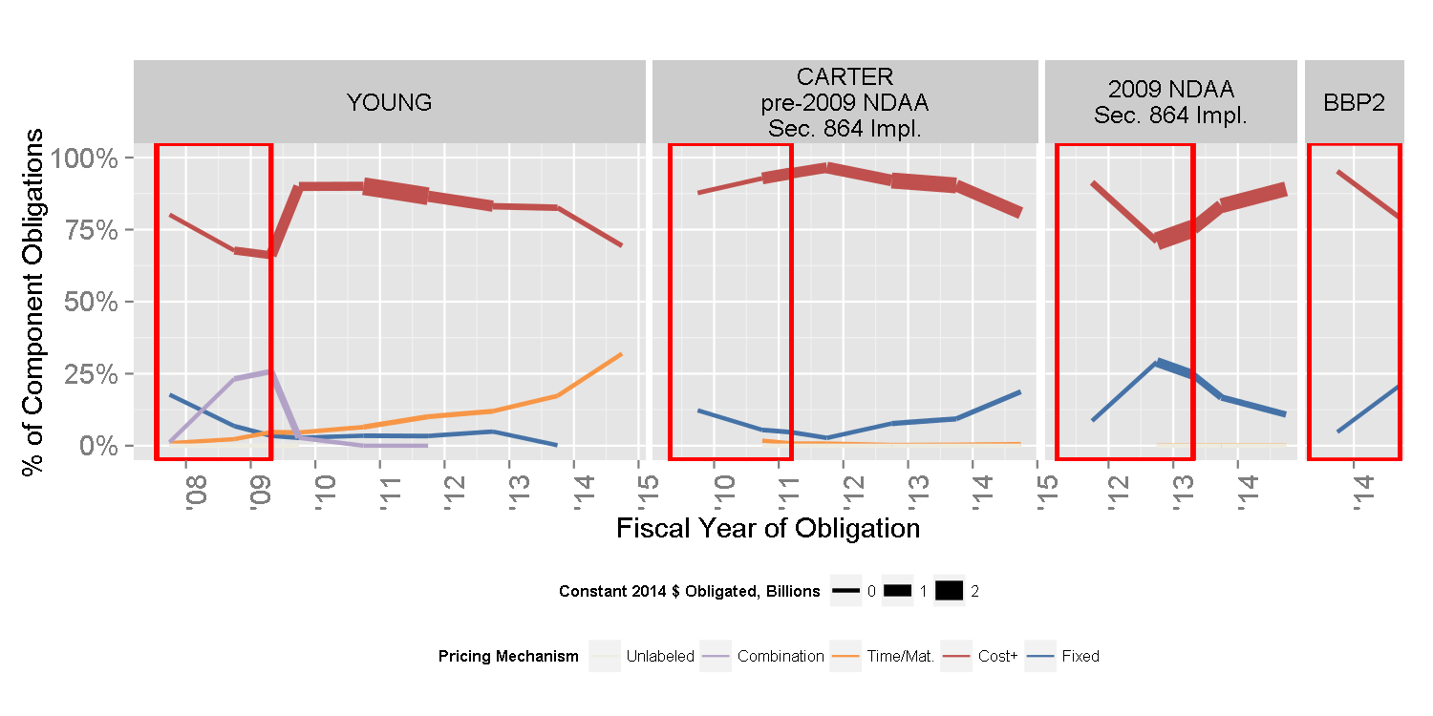
MDA Pricing Mechanism by Starting Regime

Slide 24
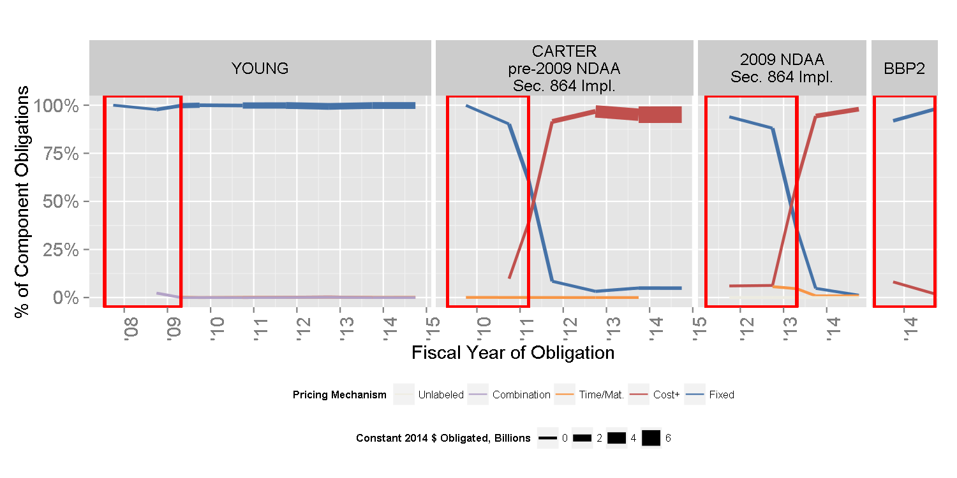
Military Health Pricing Mechanism by Starting Regime

